Slide 1
Category review: Chips
June 2020
Retail Analytics
Brand note: If client logo is not required, use alternate title page layout right click slide thumbnail > Layout > Title

Slide 2
Notes:
To view Privacy video explaining how important data privacy is to Quantium, please click here: https://www.youtube.com/watch?v=Zq1QDAkoRzU
or here Q:\Company Reference\Brand & Design\Brand videos\Q Privacy.mp4
At Quantium, we believe that data is the behavioural footprint of humanity and that it has to be treated with the utmost care and responsibility.
Histories, attitudes, indeed lives are stored within it in ways that aren’t always apparent – and that’s what makes its potential so powerful.
To work with it responsibly, sensitively, we set ourselves the highest data privacy protection and governance standards.
We have spent 17 years perfecting privacy-by-design and secure-by-design principles. Central to this is not holding any personally identifiable information about people –
we neither receive it, and put the necessary protections in place to be unable to decipher it.
Every aspect of handling data is safeguarded: from its de-identification, to its encryption – data security is paramount and of the highest grade.
We pride ourselves on gaining the trust of iconic organisations around the world through years of securely working with their data,
and in turn the trust that builds with their stakeholders.

Slide 3
Executive summary
Analyzed transaction and customer data to understand chip-buying behavior.
Identified Mainstream and Budget customers as the largest contributors to chip sales.
Young Singles/Couples and Midage Singles/Couples emerged as top-performing lifestage groups.
Pack size preference showed high sales in 175g and 150g packs, suggesting optimal product sizing.
Recommended targeting mainstream young families and singles with popular pack sizes for higher
conversion.
01
Task 1: Customer Segment Insights
Evaluated sales impact of new layout trials in Stores 77, 86, and 88 using matched control stores.
Store 88 showed exceptional growth in trial period (+3592%) indicating strong layout effectiveness.
Store 86 had a modest improvement in sales (+9.76%), suggesting moderate success.
Store 77 saw a significant drop in sales (−74.94%), indicating layout failure.
Recommendation: Proceed with selective rollout of trial layout to stores similar to Store 88 and
monitor performance before wider implementation.
02
Task 2: Trial Layout Performance

Slide 4
01
Customer Segment Insights

Slide 5

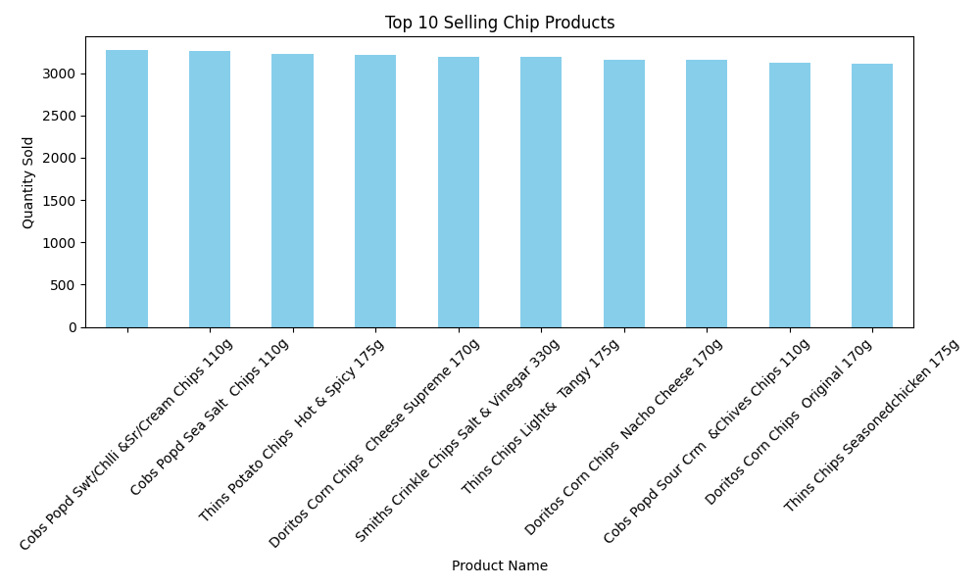
This bar chart highlights the top 10 chip products by quantity sold. It clearly shows that certain products dominate the market, indicating strong customer preferences.

Slide 6

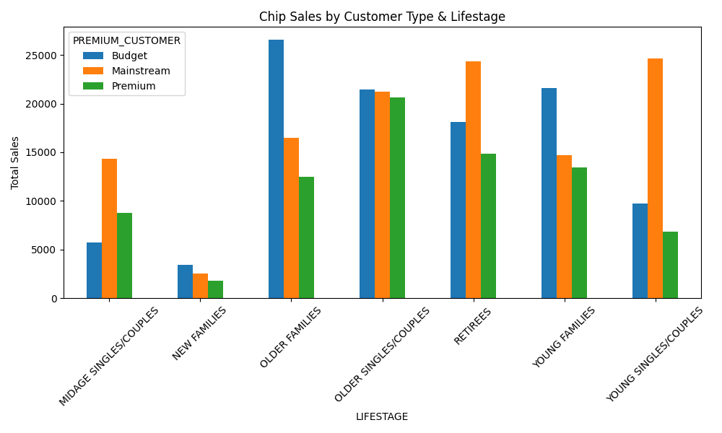
The combination of Mainstream and Young Singles/Couples shows the highest sales. Targeting this specific group could drive higher ROI from promotions.

Slide 7
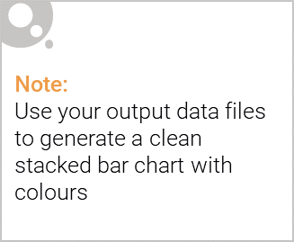
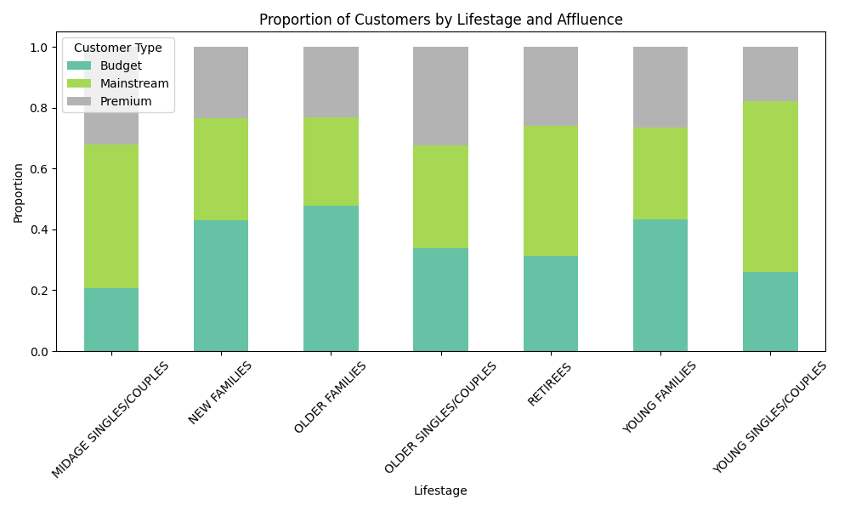
Editable (delete this)
This chart shows the proportion of customers in each lifestage by affluence level. Young and midage groups tend to be dominated by Mainstream and Budget customers, with Premium customers forming a smaller share across most segments.

Slide 8
02
Trial Layout Performance

Slide 9
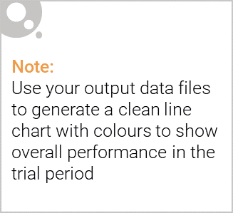
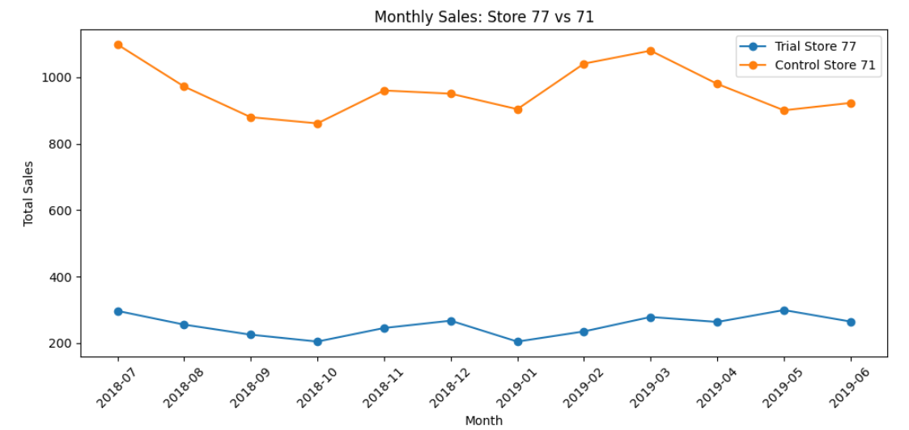
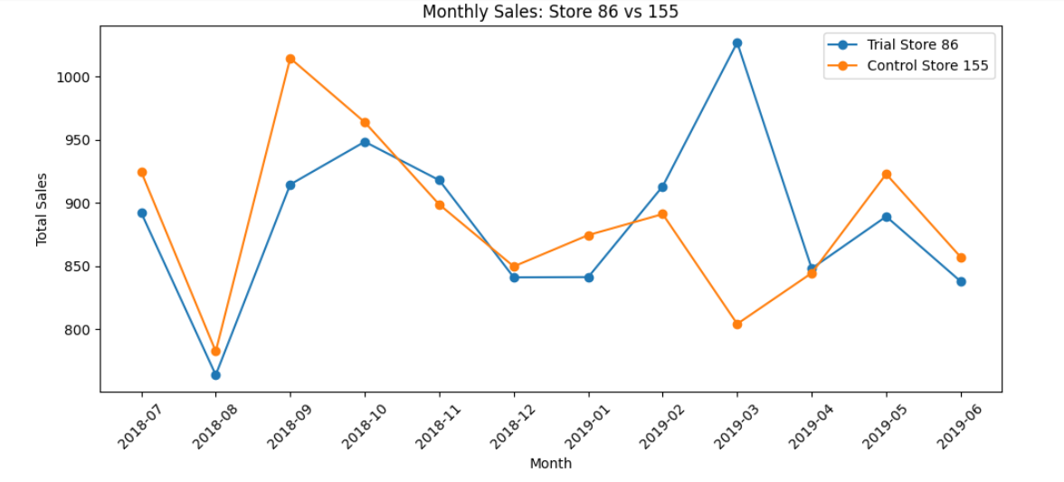
Explanation of the control store vs other stores
To assess the impact of the new layout, a control store was selected for each trial store based on similarity in sales
and customer behavior prior to the trial period. This ensures a reliable comparison unaffected by the layout change.
Store 77 → Control: Store 71 These stores had similar monthly sales and customer patterns pre-trial, making Store 71 a reliable baseline.
Store 86 → Control: Store 155 Both stores exhibited comparable performance trends before the trial began, supporting an effective comparison.
Store 88 → Control: Store 159 Store 159 showed aligned pre-trial metrics with Store 88, allowing us to isolate the impact of the new layout.

Slide 10
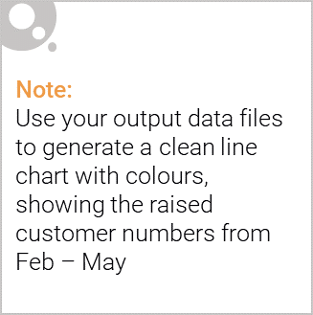
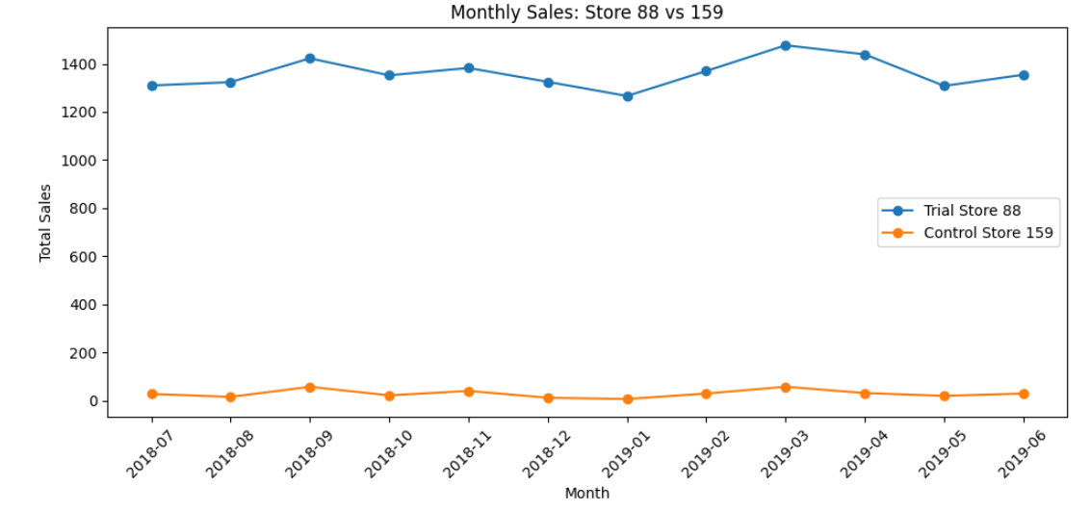
Store 88 saw a dramatic sales spike compared to its control, Store 159. This strongly supports the success of the layout trial in this location.

